Slide 1

Earth’s Features
Experience 6
Preventing Changes in the Land
https://sites.google.com/wflboces.org/boces4science/home
Grade 2

Slide 2
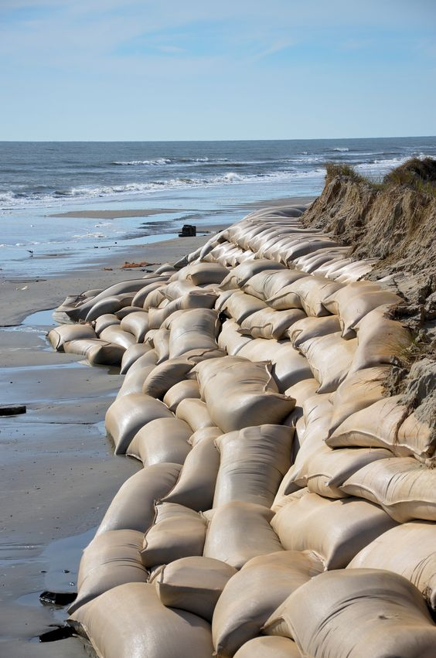
Earth Events change the shape of the land
Earth events can change the surface of the Earth quickly like hurricanes, tornadoes, or earthquakes.
Earth events can change the surface of the Earth slowly like weathering, mountain building or glacier melting.
Engineers create ways to prevent the changes on Earth. There are dams,
aqueducts, vegetation roots to hold soil, storm drains, hurricane straps
to hold down a roof, barriers of many different materials, sandbags, and
more.

Slide 3
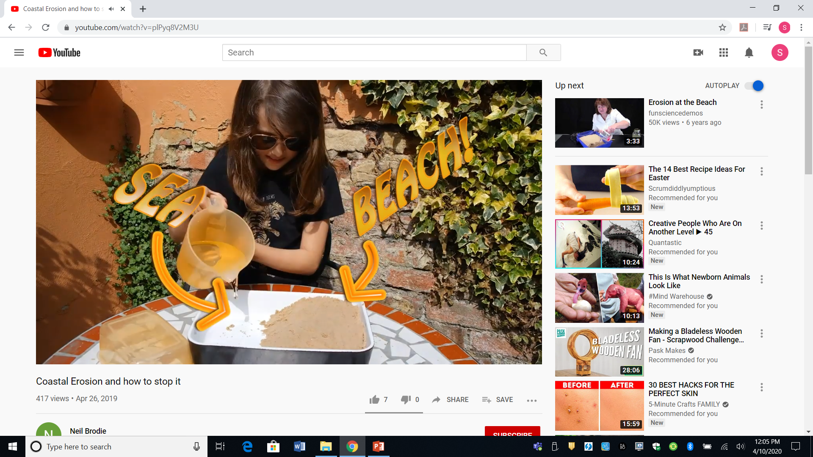
Compare solutions to prevent or reduce wind or water from changing the eArth’s surface
Students compare different solutions to prevent wind or water from changing the land.
They can do this by researching different solutions on the internet. This might be the easiest at home. Included with the student worksheets for Session 6 are 2 readings, one about ways to prevent water and one about preventing wind from changing the land. Students will need help reading them. The following link also has readings about solutions, however at a higher reading level.
https://eschooltoday.com/natural-disasters/floods/flood-prevention-methods.html flood prevention reading
This video link is very good with a British girl’s experiment with legos showing a break-wall and Riprap (large rocks). It only shows the 2 solutions but it’s a start.
https://www.youtube.com/watch?v=plPyq8V2M3U British girl’s experiment (2 solutions)

Slide 4
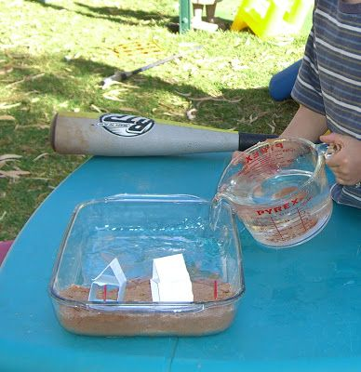
Experimenting with preventing the wind or water from changing the Earth’s Surface.
To do an experiment, students can:
use sand or dirt (a bit messier) in a pie tin, paint tray or other container to make a beach
make a house using legos, paper, a small box, etc. and put it on the beach
Add ~1/2 – 1 cup of water to create the ocean and swish it to break down the beach or using a straw carefully blow the sand away from beach (and eyes!).
Prevent the water/wind from changing the land
Use materials around the house and outside to build something to block the wind or water. Use blocks, legos, sticks, rocks, etc… try your solution
Try a second way using different materials and compare the 2 solutions!

